Slide 1
Problem Manage a Server Outage Scenario & an Issue & Change Request Management System
Module Project
Module: NICF Capstone Project using Java
Course: NICF Advanced Certificate in Software & Applications (Development & Deployment)
Start Date : 22 September 2022
End Date : 31 October 2022
Submission Date : 21 October 2022
Learner Name : Wildan Luqmanul Hakim
Enrollment ID : BDSE-0322/STTB
Presentation Date :

Slide 2
Contents
Document History
Version Number | Effective Date of release | Summary of Included Changes | Author
1 | 4th March 2016 | First Edition | Satya CVS
2 | 23rd Jul 2018 | Changed for Module 6 | Shrinivas K R

Slide 3
Contents
Contents
S. No. | Description
01 | Principles of Problem Management
02 | Problem Management Example
03 | Tools, Process & Technologies
04 | Investigation & Diagnosis
05 | Explain Prioritization
06 | Problem Management Solution
07 | Systems you will Implement
08 | Project Milestones & Tasks
09 | Milestone Feedback & Action taken
10 | Modifications Made based On Feedback
11 | Project Results
12 | Proposed Improvements

Slide 4
1. Principles of Problem Management
Principles of Problem Management
Problem Identification An incident report or an analysis of an existing incident can detect a problem. It is most likely when the cause of an occurrence or series of incidents is unknown. Proactive problem detection is critical for preventing future service interruptions.
Problem Logging Problems must be documented for future reference. The type, description, associated incidents, category, user information, status, resolution, and closure of the problem must all be documented. This data is required to identify and manage known issues in a database.
Problem Investigation When conducting a root cause analysis, the severity and urgency of the problem must also be considered. A common investigation technique is to search the Known Error Database (KEDB) for similar issues. The best course of action to address the issue is then chosen.

Slide 5
1. Principles of Problem Management
Principles of Problem Management
Resolution Following the identification and resolution of the problem, the solution can be implemented using a standard change procedure. It is also critical to ensure the restoration of service. To solve the problem permanently, a new change must be implemented. Change Management is in charge of assessing, planning, and carrying out changes.
Review It is critical to review the problem's resolution and its impact on the business at this stage, as well as conduct a risk assessment. This ensures that the problem-solving process is efficient and that it is constantly improved for the future. This review has been documented and distributed to the appropriate teams and individuals.

Slide 6
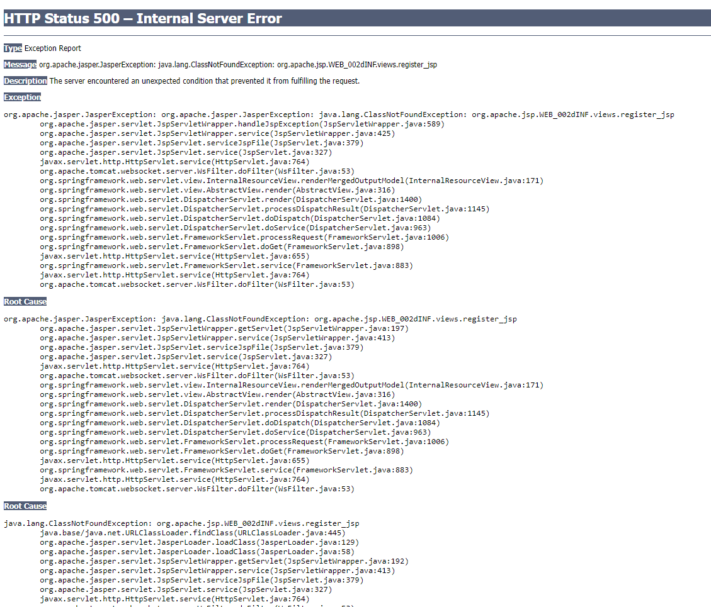
2. Problem Management Example
Problem Identification The root cause of this development process error is "org.apache.jsp.WEB_002dINF.views.register_jsp”
Problem Investigation Possibly because there is a typo in the element or object.

Slide 7
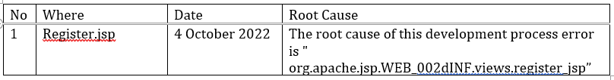
2. Problem Management Example
Problem Logging
Resolution Open and check register.jsp then change the typo element from <form> to <form:form>
Review Do the code typing correctly so that there are no errors in typing

Slide 8
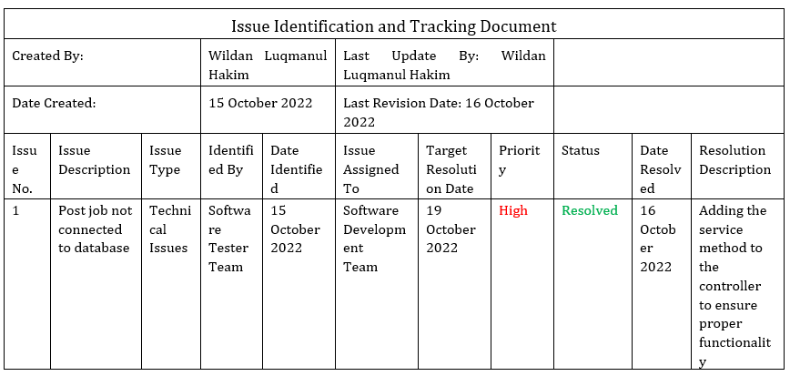
3. Tools, Process & Technologies
Tools, Process & Techniques
Problem Logging
Techniques = Issue Tracking System Issue tracking systems track the progress of issues in software applications so that problems and their status can be identified more easily.
Tool = Excel sheet Creating a tracking document template in Excel is a useful tool for problem identification.
Process:

Slide 9
3. Tools, Process & Technologies
Problem Investigation
Techniques = Root Cause Analysis Tool = Fishbone The Fishbone is a fantastic visualization tool for identifying multiple root causes. It had the shape of a fish's skeleton, with the problem's effect on the right side and potential causes represented by the fish's spine on the left.
Process:
Define the problem statement clearly.
Add fishbones as categories of possible causes.
Determine the link between the root cause and the problem.
Primary and secondary causes are classified and prioritized.

Slide 10
3. Tools, Process & Technologies
Problem Resolution
Techniques = Known Error Database Known Error Database (KEDB) is a database of all known problems that been documented by the software developer application. Tool = Excel Sheet Creating a tracking document template in Excel is a useful tool for problem identification. Process:
Recording known errors
Make a known error record that includes the symptoms and resolution information.
Obtaining known error records
Check KEDB and apply the fix
Removal of known error records
Implemented a permanent solution

Slide 11
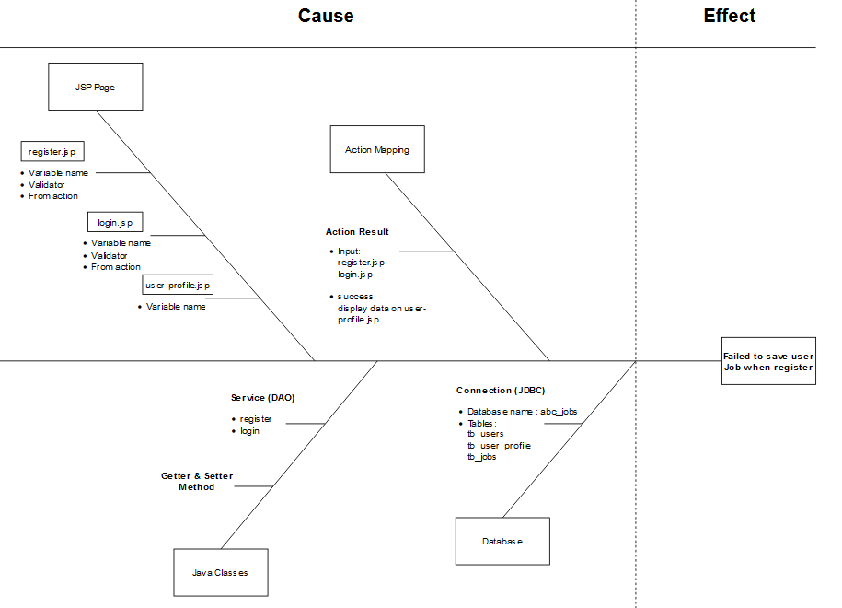
4. Investigation & Diagnosis
Diagnose the problem
Diagnosing the root cause:
“Value not present”
It most likely because the jsp form value for job is not present any value

Slide 12
5. Explain Prioritization
Prioritize and Categories problems:
Tier 1: Low priority issues The first tier is for basic or minor problems Example: Some words on the website have typos
Tier 2: Medium priority issues The second tier is the major problems Example: The register page is broken and does not save to the database
Tier 3: High priority issues The third tier is the critical problems Example: The website server is down, and a hacker has attacked it

Slide 13
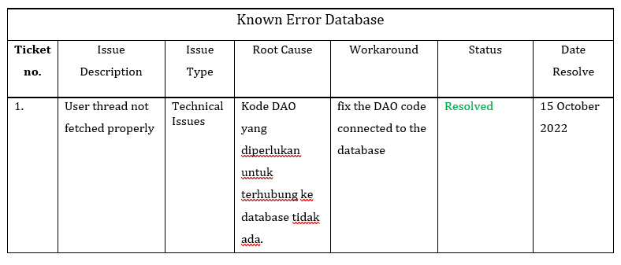
6. Problem Management Solution
Case problem: User thread is not displayed properly after user created a post thread.
Solution:
Examine the controller and service method responsible for retrieving the post thread database.
Correct the appropriate function/method.
Evaluate the functionality
Once the problem has been resolved, record it in the KEDB table to prevent it from recurring.
Known error Database (KEDB)

Slide 14
7. Systems you will Implement
Apply Job
Users (Software Programmer)
User Job Page
List Job Page
Apply Job functionality
Apply Job history
Search Job functionality
Admin
Manage Jobs
Manage Job Applicants

Slide 15
7. Systems you will Implement
Threads
User Thread
Read Thread
Comment Thread
List Thread
Search Thread Functionality
Post Thread
Edit Thread

Slide 16
8. Project Milestones & Tasks
Project Task ID | Project Task Description | Project Milestone ID
1 | Identify problems and develop issue tracking documents | 1
2 | Problem investigation and diagnosis | 1
3 | Problem prioritization | 1
4 | Problem resolution | 2
5 | Creating a known error database | 3

Slide 17
9. Milestone Feedback & Action taken
Project Milestone ID | Milestone Feedback received from Tutor / Learning Facilitator | Action Taken (Yes / No)

Slide 18


11. Project Results
List evidence of the project Results

Slide 19
12. Proposed Improvements
List of Improvements
Learn problem management in more detail
Describe all problems that occur during development
Provide clear and detailed solutions to problems that occur

